Slide 1
Simple Machines Game Show!!
Family Feud
Who wants to be a Millionaire?
Wheel of Fortune
Jeopardy

Slide 2
Game Show 1 – Family Feud
Types of Levers
200
100
50

Slide 3
Game Show 1 – Family Feud
Types of Levers
Class 1 (E – F – L)
2
3

Slide 4
Game Show 1 – Family Feud
Types of Levers
1
Class 2 (F – L – E)
3

Slide 5
Game Show 1 – Family Feud
Types of Levers
1
2
Class 3 (F – E – L)

Slide 6
Game Show 1 – Family Feud
Class 1 Levers
300
150
250
100
200

Slide 7
Game Show 1 – Family Feud
Class 1 Levers
Teeter Totter
D
B
E
C

Slide 8
Game Show 1 – Family Feud
Class 1 Levers
A
D
Pliers
E
C

Slide 9
Game Show 1 – Family Feud
Class 1 Levers
A
D
B
E
Sizzors

Slide 10
Game Show 1 – Family Feud
Class 1 Levers
A
Crowbar
B
E
C

Slide 11
Game Show 1 – Family Feud
Class 1 Levers
A
D
B
Neck & Head
C

Slide 12
Game Show 1 – Family Feud
Class 2 Levers
200
100
50

Slide 13
Game Show 1 – Family Feud
Class 2 Levers
Wheelbarrow
B
C

Slide 14
Game Show 1 – Family Feud
Class 2 Levers
A
Nutcracker
C

Slide 15
Game Show 1 – Family Feud
Class 2 Levers
A
B
Foot, Ankle, Calf (Lower leg)

Slide 16
Game Show 1 – Family Feud
Class 3 Levers
300
150
250
100
200
50

Slide 17
Game Show 1 – Family Feud
Class 3 Levers
Fishing Rod
D
B
E
C
F

Slide 18
Game Show 1 – Family Feud
Class 3 Levers
A
D
Hockey Stick
E
C
F

Slide 19
Game Show 1 – Family Feud
Class 3 Levers
A
D
B
E
Shovel
F

Slide 20
Game Show 1 – Family Feud
Class 3 Levers
A
Chopsticks
B
E
C
F

Slide 21
Game Show 1 – Family Feud
Class 3 Levers
A
D
B
Golf Club
C
F

Slide 22
Game Show 1 – Family Feud
Class 3 Levers
A
D
B
E
C
Bicep, Elbow, Weight in Hand

Slide 24
Game Show 2 – Millionaire?
An Inclined Plane can also be referred to as a ______?
POINTS
100
200
300
400
500
A. Hill
C. Ramp
B. Wooden Board
D. Airplane

Slide 25
Game Show 2 – Millionaire?
An Inclined Plane can also be referred to as a ______ ?
POINTS
100
200
300
400
500
A. Hill
C. Ramp
B. Wooden Board
D. Airplane

Slide 26
Game Show 2 – Millionaire?
What is the unit for Force?
POINTS
100
200
300
400
500
A. Newtons
C. Watts
B. Joules
D. Meters

Slide 27
Game Show 2 – Millionaire?
What is the unit for Force?
POINTS
100
200
300
400
500
A. Newtons
C. Watts
B. Joules
D. Meters

Slide 28
Game Show 2 – Millionaire?
In the inclined plane/mechanical advantage experiment, as the height of the ramp increased, the ______ ______ .
POINTS
100
200
300
400
500
A. Load force; increased
C. Load force; decreased
B. Effort force; increased
D. Effort force; decreased

Slide 29
Game Show 2 – Millionaire?
In the inclined plane/mechanical advantage experiment, as the height of the ramp increased, the ______ ______ .
POINTS
100
200
300
400
500
A. Load force; increased
C. Load force; decreased
B. Effort force; increased
D. Effort force; decreased

Slide 30
Game Show 2 – Millionaire?
What is the formula for Mechanical Advantage?
POINTS
100
200
300
400
500
A. Load Force/Effort Force
C. Output Force/Input Force
B. Effort Arm/Load Arm
D. All of the above

Slide 31
Game Show 2 – Millionaire?
What is the formula for Mechanical Advantage?
POINTS
100
200
300
400
500
A. Load Force/Effort Force
C. Output Force/Input Force
B. Effort Arm/Load Arm
D. All of the above

Slide 32
Game Show 2 – Millionaire?
What is the unit for Mechanical Advantage?
POINTS
100
200
300
400
500
A. Meters
C. Joules
B. No Unit
D. Newtons

Slide 33
Game Show 2 – Millionaire?
What is the unit for Mechanical Advantage?
POINTS
100
200
300
400
500
A. Meters
C. Joules
B. No Unit
D. Newtons

Slide 34
Game Show 2 – Millionaire?
What is the Mechanical Advantage of a Class 2 lever carrying a load of 1200g where the Effort Force is 7.0 N?
POINTS
100
200
300
400
500
1000!!!
A. 0.6
C. 1.7
B. 1.8
D. 0.7

Slide 35
Game Show 2 – Millionaire?
What is the Mechanical Advantage of a Class 2 lever carrying a load of 1200g where the Effort Force is 7.0 N?
POINTS
100
200
300
400
500
1000!!!
A. 0.6
C. 1.7
B. 1.8
D. 0.5

Slide 36
Game Show 3 – Wheel of Fortune!
Two turning objects that are attached to each other at their centers, and one causes the other to turn.

Slide 37
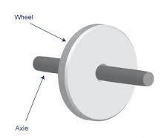
Game Show 3 – Wheel of Fortune!
Two turning objects that are attached to each other at their centers, and one causes the other to turn.
A
W
H
E
E
L
A
N
D
A
X
L
E

Slide 38
Game Show 3 – Wheel of Fortune!
A Wheel and Axle Invention

Slide 39
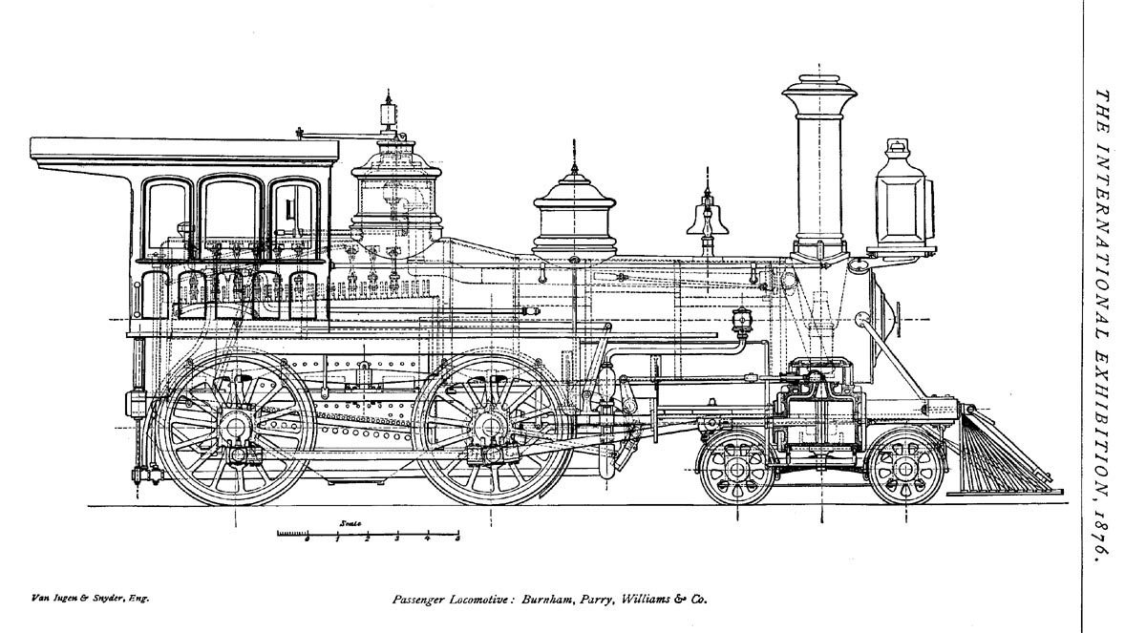
Game Show 3 – Wheel of Fortune!
A Wheel and Axle Invention
S
T
E
A
M
L
O
C
O
M
O
T
I
V
E
W
H
E
E
L

Slide 40
Game Show 4 - Jeopardy
Wheels & Gears
Pulleys
Work & Energy
100
100
100
200
200
200
300
300
300

Slide 41
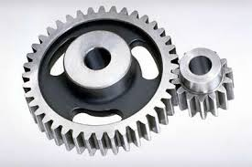
Game Show 4 - Jeopardy
Another name for driven gear.

Slide 42
Game Show 4 - Jeopardy
What is ….
Follower

Slide 43
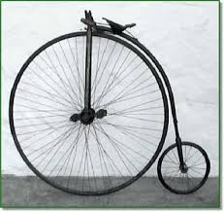
Game Show 4 - Jeopardy
In a wheel and axle system with two differently sized wheels, when you move the smaller of the two wheels, the result is _________.

Slide 44
Game Show 4 - Jeopardy
What is ….
Distance

Slide 45
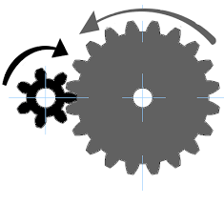
Game Show 4 - Jeopardy
The speed ratio for these two gears.
Driven
Driver

Slide 46
Game Show 4 - Jeopardy
What is …
2.86

Slide 47
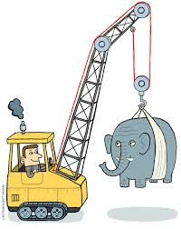
Game Show 4 - Jeopardy
The class lever a pulley is most similar to.

Slide 48
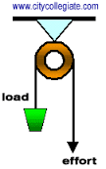
Game Show 4 - Jeopardy
What is …
Class One

Slide 49
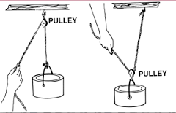
Game Show 4 - Jeopardy
A type of pulley where the direction of the effort force is up.

Slide 50
Game Show 4 - Jeopardy
What is …
Movable

Slide 51
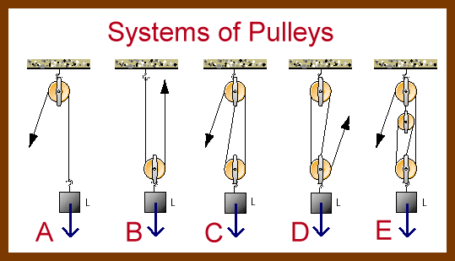
Game Show 4 - Jeopardy
The pulley that creates the greatest amount of mechanical advantage:

Slide 52
Game Show 4 - Jeopardy
What is … E; A Compound Pulley

Slide 53
Game Show 4 - Jeopardy
A transfer of Energy
AND
It can be neither created nor destroyed
(2 words)

Slide 54
Game Show 4 - Jeopardy
What is …
Work
&
Energy

Slide 55
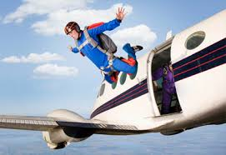
Game Show 4 - Jeopardy
Stored energy of a skydiver.

Slide 56
Game Show 4 - Jeopardy
What is …
Gravitational Potential Energy

Slide 57
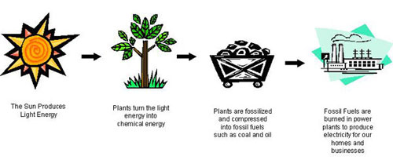
Game Show 4 - Jeopardy
What does the picture show?

Slide 58
Game Show 4 - Jeopardy
What is …
Energy Transmission

Slide 59
Thanks for Playing!

